Slide 1

E-Commerce Sales &
Profit Performance
Power BI Dashboard • DAX Measures • Interactive Analytics • 2023–2025
533.67M
79.71M
15%
106.73K
Total Sales
Total Profit
Profit Margin
Avg Order Value
Overview
Sales & Profit
Products
Customers
Discount Impact

Slide 2
Project Objective
CHALLENGES
SOLUTION
No unified view of sales performance
Difficulty tracking profitability trends
No product/category intelligence
Unclear customer spending patterns
Unknown discount effectiveness
Missing year-over-year growth view
An interactive Power BI dashboard transforming raw e-commerce data into strategic business intelligence.
5 focused analytical dashboard pages
Real-time KPI cards with DAX measures
Interactive slicers & cross-filtering
YoY growth & discount impact analysis
Customer lifetime value & AOV tracking

Slide 3
Data Modeling & DAX Measures
533.67M
79.71M
15%
Total Sales
Total Profit
Profit Margin %
SUM(Sales[Sales])
SUM(Sales[Profit])
DIVIDE([Total_Profit],[Total_Sales])
106.73K
84.91%
4M–6M
AOV
YoY Revenue Gr%
Discount Impact
DIVIDE([Total_Sales],[Order Count])
DIVIDE([Sales]-[LY Sales],[LY Sales])
[Total_Sales]-[Sales_No_Discount]

Slide 4
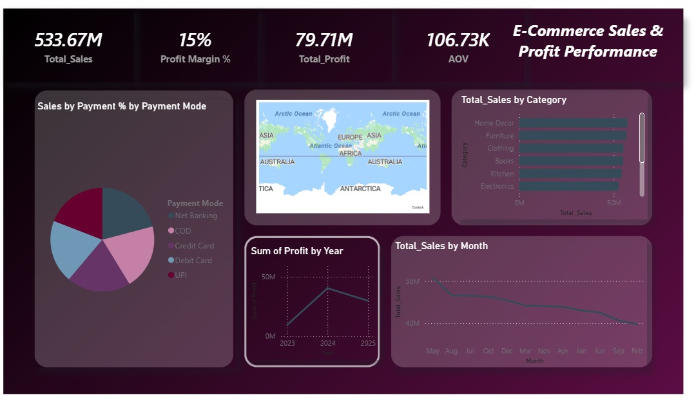
Page 1 — Overview Dashboard
E-Commerce Sales & Profit Performance
KPIs: Total Sales 533.67M • Profit Margin 15% • Total Profit 79.71M • AOV 106.73K • Payment Mode distribution • Monthly & Category trends

Slide 5
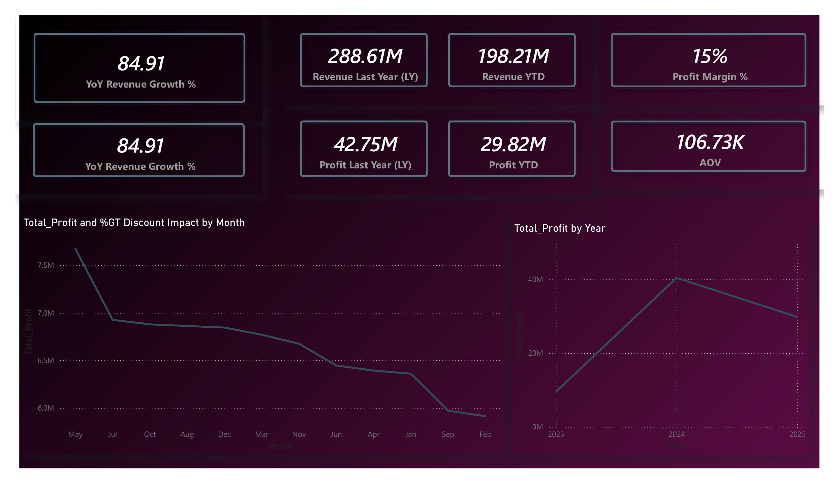
Page 2 — Sales Performance Analysis
84.91%
YoY Growth — Strong year-over-year revenue expansion
288.61M
Revenue LY — Last year baseline for comparison
2024
Profit Peak — Profit peaked at 40M+ before slight decline
29.82M
Profit YTD — Current year profit trending lower vs LY
Key finding: Profit peaked in 2024 then declined — discounts may be compressing margins despite strong revenue growth

Slide 6
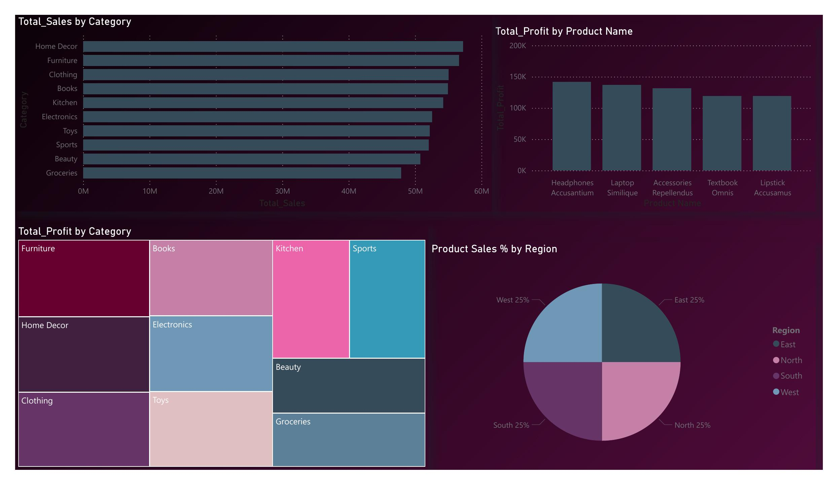
Page 3 — Product & Category Intelligence
Key Insights
Top Category
Home Decor leads in total sales
Equal Regions
East, West, North, South all at 25%
Top Product
Headphones/Laptop highest profit
Furniture
Leads profit by category (treemap)
10 Categories
Broad portfolio with diverse revenue
Visuals: Horizontal bar charts (Sales & Profit) • Treemap (Profit by Category) • Pie chart (Regional distribution)

Slide 7
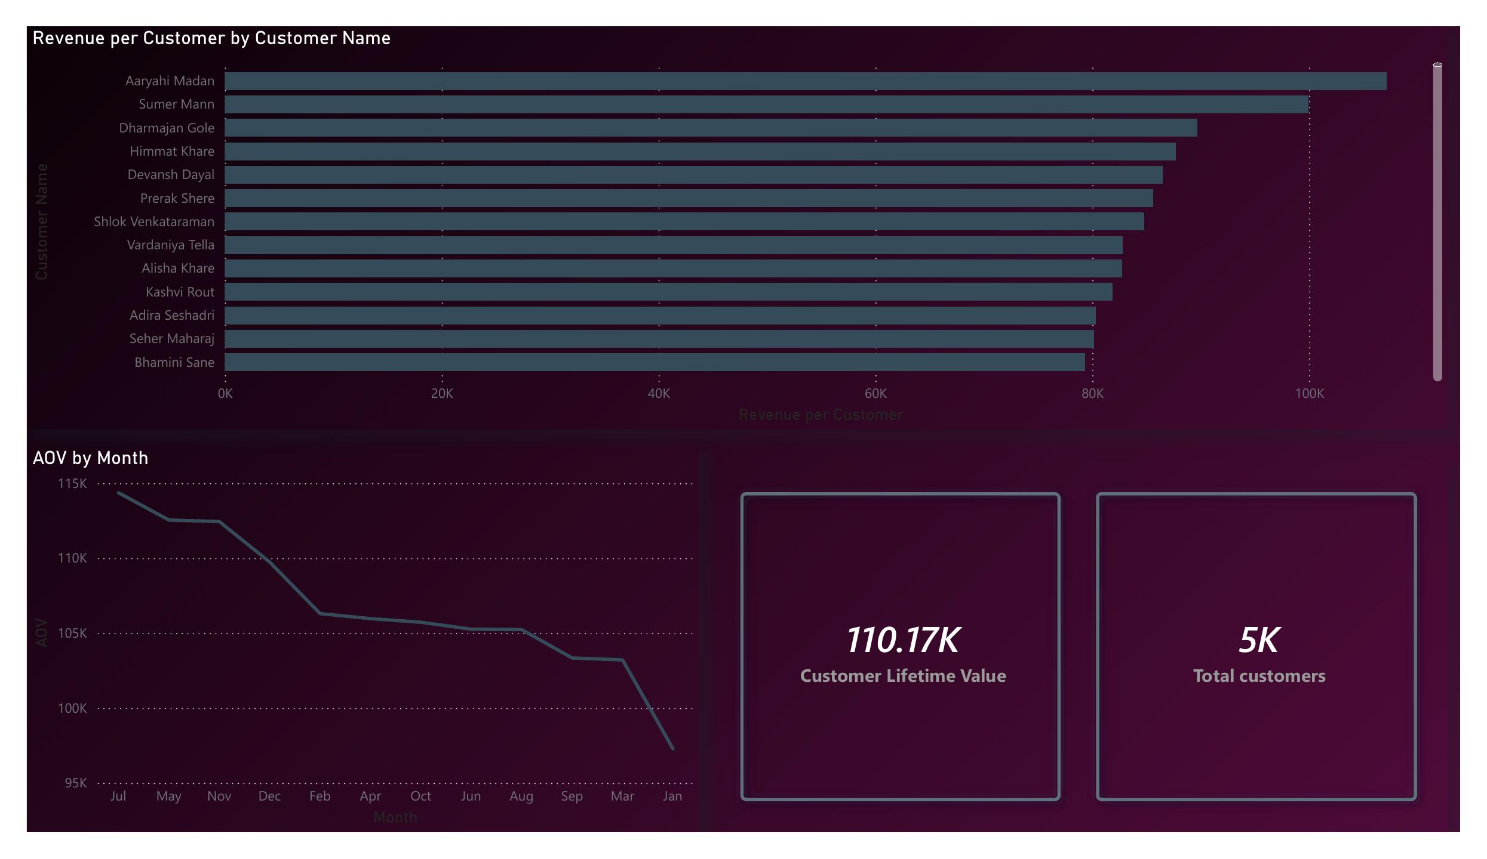
Page 4 — Customer Insights
110.17K
Customer Lifetime Value
5K
Total Customers
106.73K
Avg Order Value (AOV)
AOV declining from ~115K (Jul) to 95K (Jan) — indicates end-of-year spending compression
Visuals: Revenue per Customer bar chart • AOV by Month trend line • CLV & Total Customers KPI cards

Slide 8
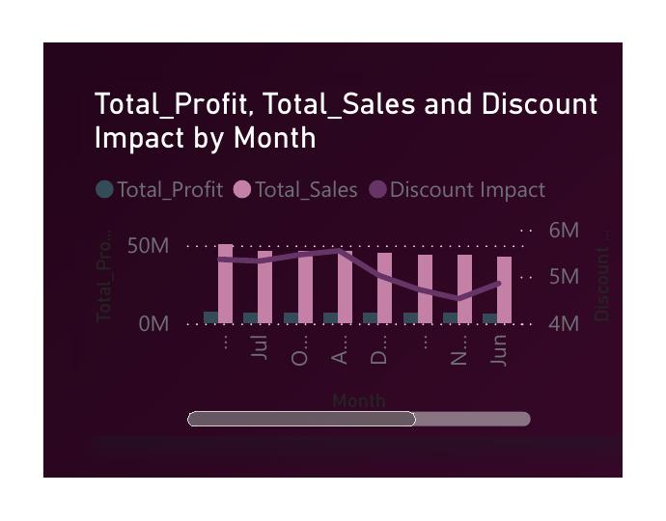
Page 5 — Discount Impact Analysis
Discount Findings
Sales ~50M/month
Consistent total sales volumes across months
Profit 6M–7.5M
Monthly profit ranges, impacted by discounts
Discount 4M–6M
Discount impact erodes margin quality
Declining trend
Profit decreasing from May to Feb — discount creep
Visual: Line & Clustered Column combo — Total_Profit, Total_Sales, and Discount Impact by Month

Slide 9
Key Business Insights
Sales Growth
Profitability
Products
YoY Revenue Growth of 84.91%
15% Profit Margin maintained
Home Decor & Furniture lead sales
Strong expansion from 2023 baseline to 2024 peak, with 2025 showing moderation.
Profit peaked in 2024 at ~40M but is declining in 2025 — discount pressure suspected.
10 categories with relatively even distribution. Headphones top product by profit.
Customers
Discounts
Regions
5,000 customers, CLV 110.17K
Discount impact: 4M–6M monthly
Equal 25% share across all regions
AOV declining from 115K (Jul) to 95K (Jan), signaling seasonal spending compression.
High discount months correlate with lower profit. Promotions compress margins significantly.
Balanced geographic performance — no single region dominates; no underperformer either.

Slide 10
Conclusion
From Raw Data to
Strategic Decisions
The dashboard empowers the business to:
Monitor $533.67M in sales with 15% margin
Track 84.91% YoY growth & profit trends
Optimize 10-category product portfolio
Understand 5K customers & CLV patterns
Evaluate 4M–6M monthly discount impact
Act on equal regional performance data
Reactive Reporting → Data-Driven Strategic Intelligence

